Slide 1
Linz-Donawitz Process
(for SS316, at 98% Purity)
Robinson Bui, Karen Izaguirre, Ezra Ju, Logan Kuhn, Esther Marroquin, Grace Wang

Slide 2
Background & Relevance

Slide 3
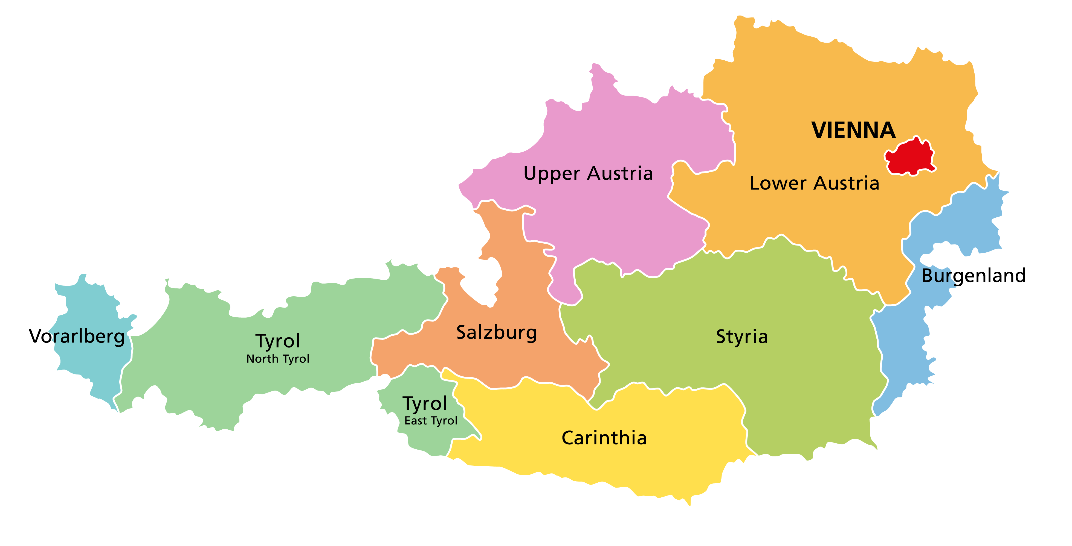
Linz-Donawitz (LD) Process History
Originated in Switzerland 1940's
Named after the first two towns it was first used in
Also known as: basic oxygen process
Linz
Donawitz

Slide 4
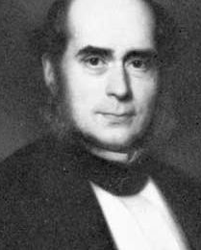
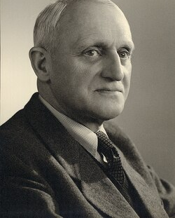
Henry Bessemer
Robert Durrer
But before that?
(1856) First inexpensive steelmaking process
(1949) LD Process discovery
Notes:
- wasn’t used
- Main difference between Bessemer process and ld air vs oxygen, why ld was not possible and efficient until high purity oxygen became available and affordable in large quant
- But for the product of our process…

Slide 5
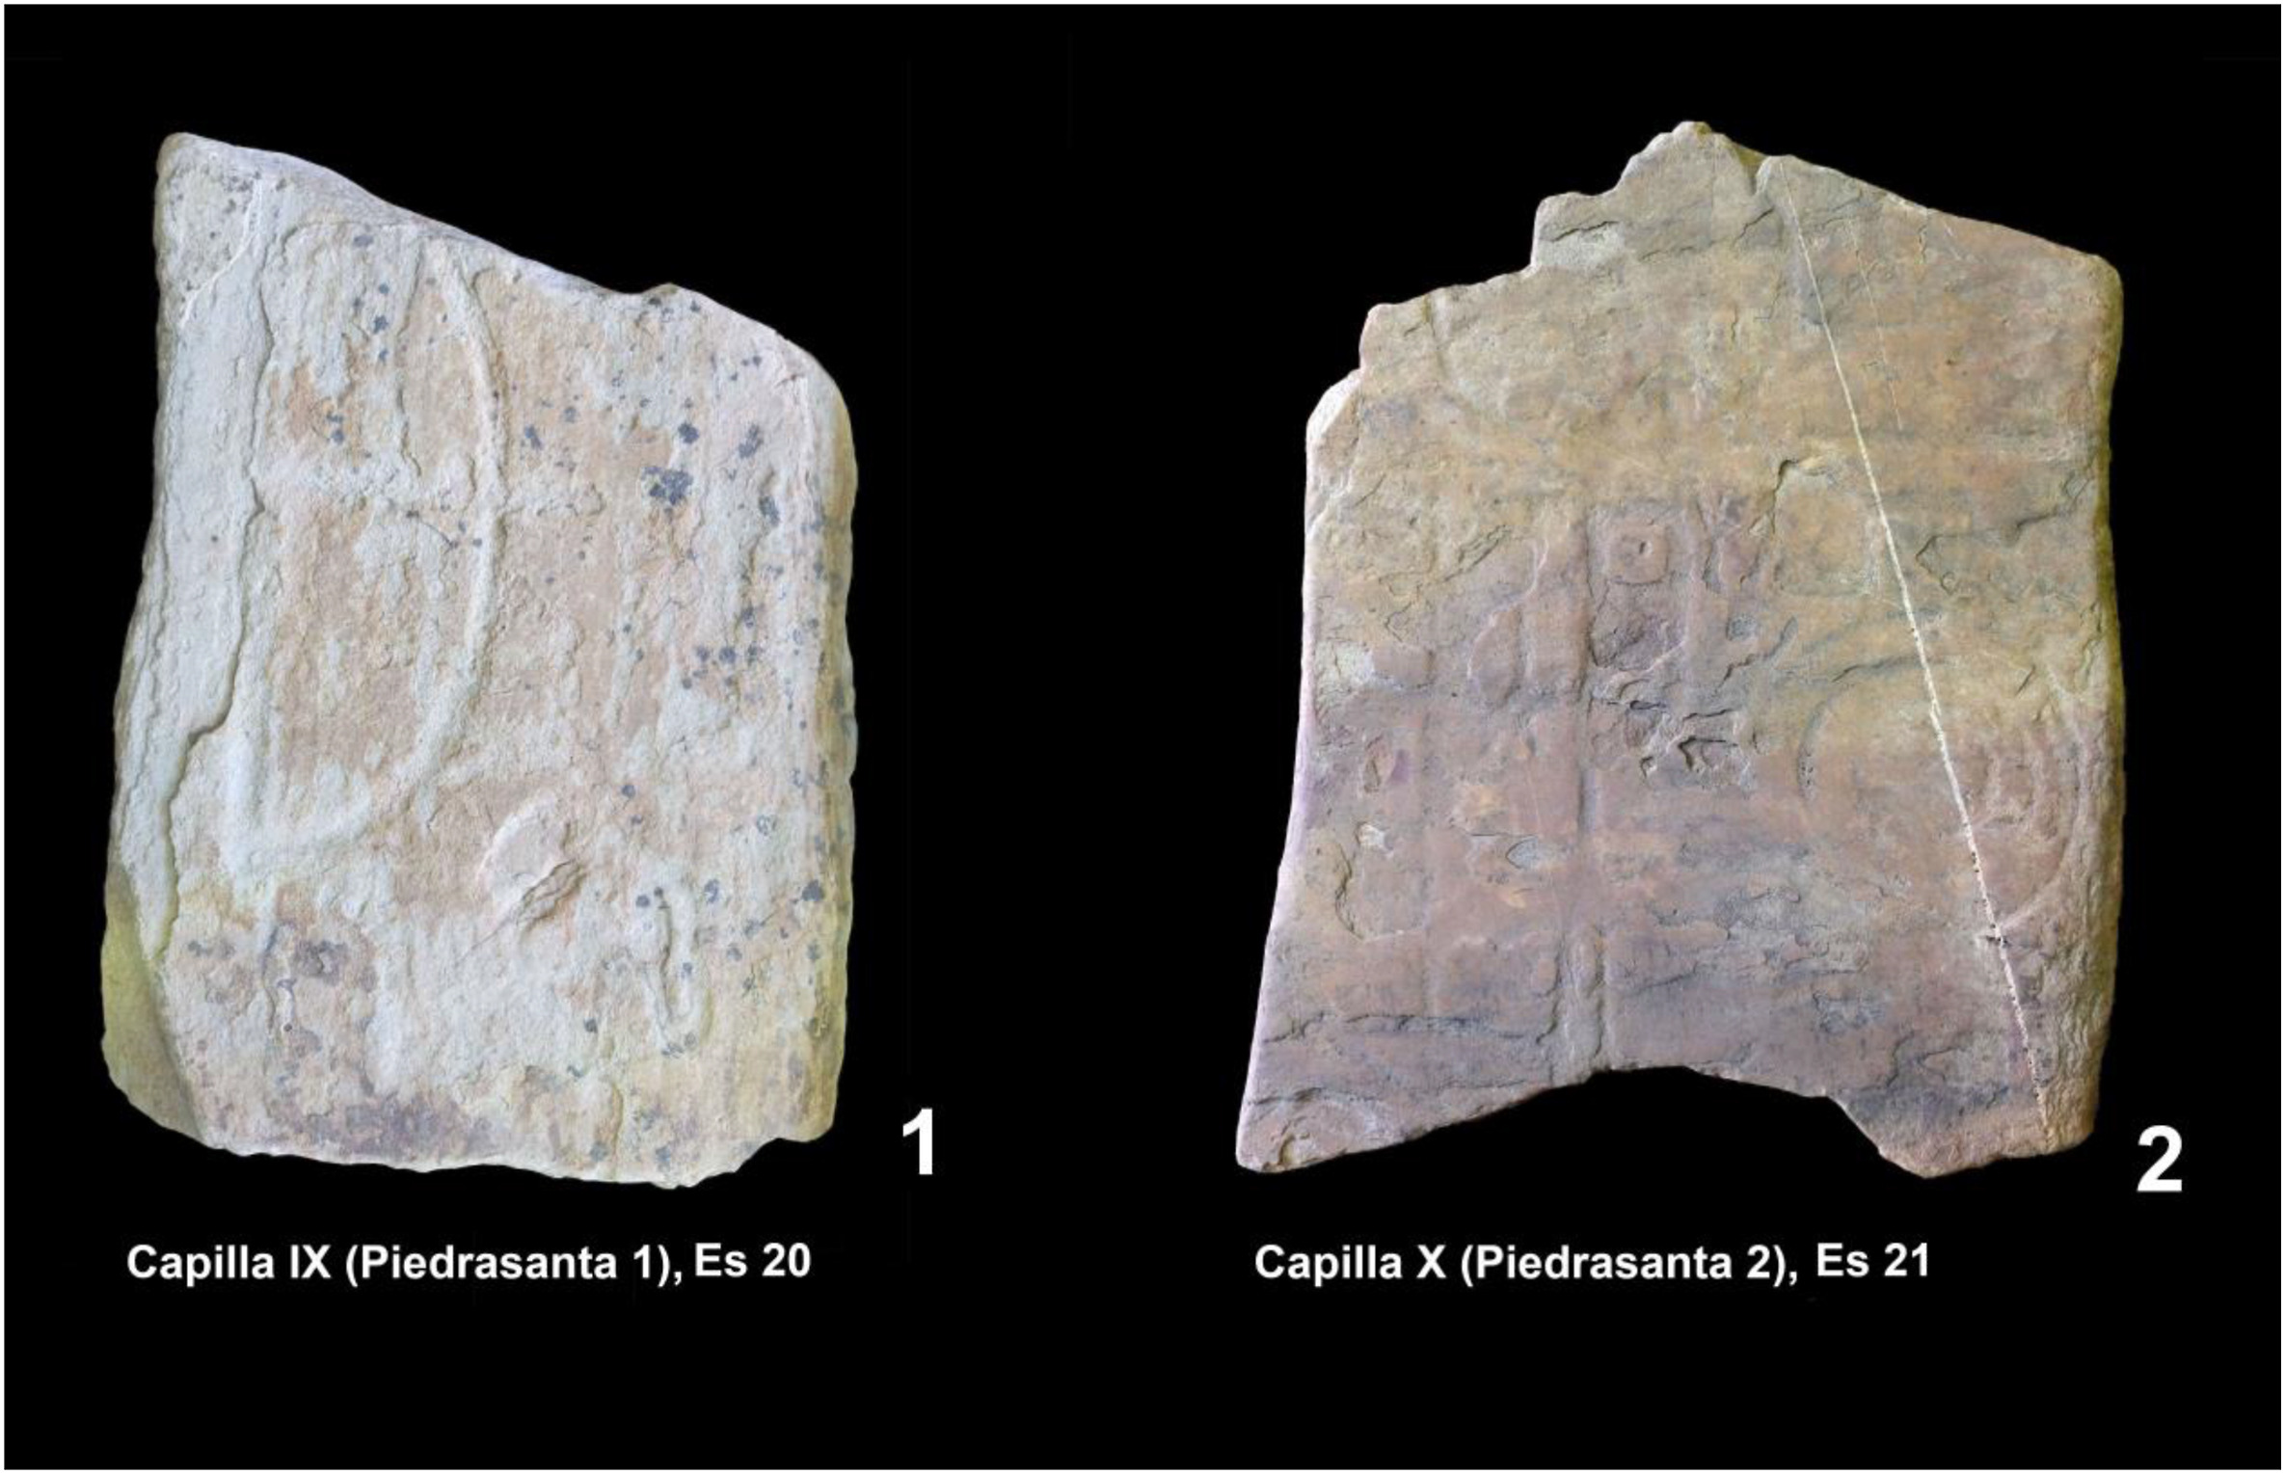
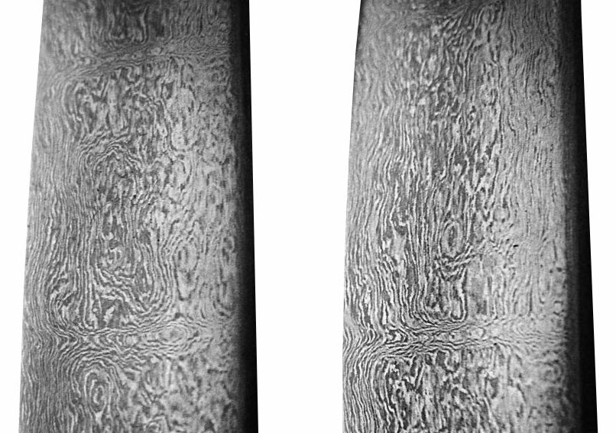
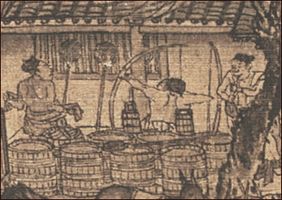
Steel History: in General
800 BCE
300 BCE
1000 CE
Evidence of steel tool use (Iberian Peninsula)
Wootz steel (India & Sri Lanka)
Steel tips for weapons Song Dynasty (China)
Notes:
Some examples…
Recent studies University of Freiburg: Iberian peninsula, stelae on rocks that could only be chiseled by steel
Wootz steel later used as lauching point for Damascus steel
Song Dynasty in 1000 CE waterwheels superheating molten ore, relevant as china is now where the majority of desired product is made
What steel is our desired product…

Slide 6
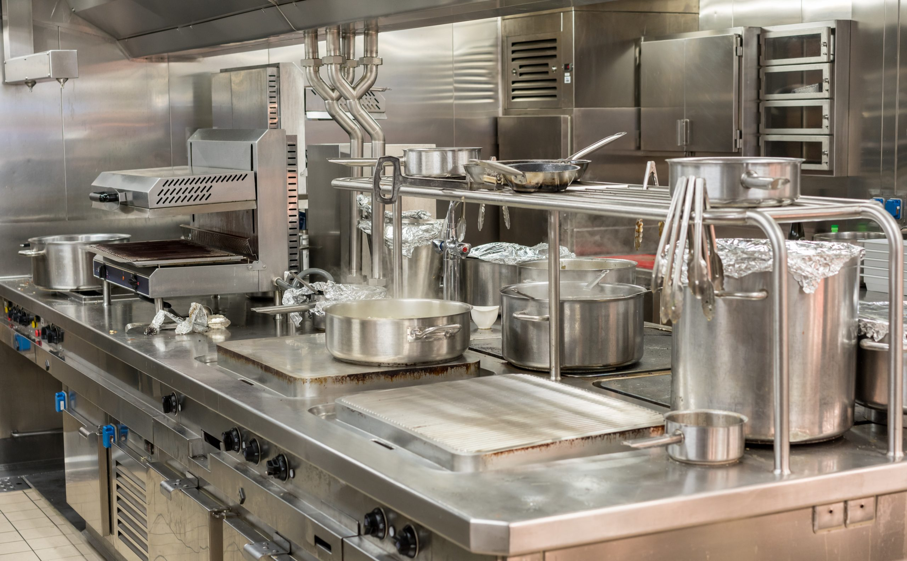
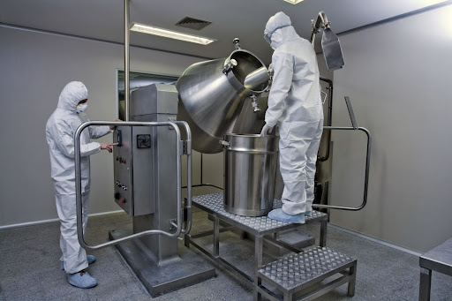
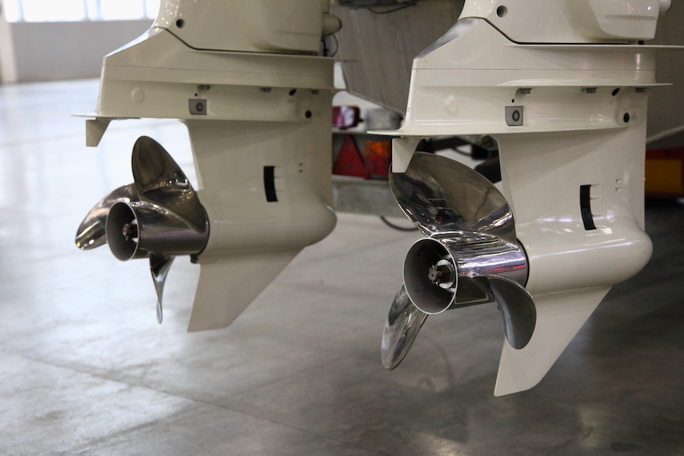
Stainless Steel SS316
Heat resistance
Corrosion Resistance
Durability
Composition:
Cr (16-18%) Si (≤ 0.75%)
Ni (10-14%) C (≤0.08%)
Mo (2-3%) P (≤ 0.045%)
Mn (≤ 2%) S (≤ 0.03%)
Notes:
If interested the typical percent compositions below % comps
Will resist under continuous 425-860°C
- talk abt
Chemical & Pharmaceutical Industry: Used in chemical tanks, processing equipment, and piping due to its resistance to corrosive chemicals.
Marine Applications: Ideal for shipbuilding, offshore platforms, and coastal structures because of its ability to withstand salty environments.
Medical Industry: Found in surgical instruments and implants due to its biocompatibility and resistance to body fluids.
Food & Beverage Industry: Used in processing equipment, storage tanks, and kitchen appliances for its hygienic properties.
Automotive & Aerospace: Components like exhaust systems and aircraft fittings benefit from its heat resistance and durability.

Slide 7
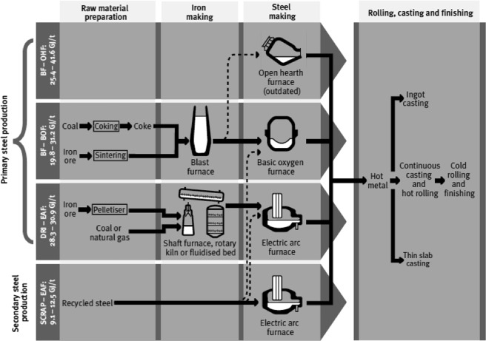
Reaction Process
The entire process of producing SS316 starts with another process involving coke, iron ore, and a blast furnace.
We’re focusing on the step after this, where the resultant pig iron is placed into a basic oxygen furnace.
Wright, R. N. (2016). Chapter 14 - Relevant Aspects of Carbon and Low-Alloy Steel Metallurgy. In Wire Technology (Second Edition, pp. 201–233). essay, Butterworth-Heinemann. Retrieved October 19, 2025, from https://www.sciencedirect.com/science/article/pii/B9780128026502000145 .

Slide 8
Problem Statement
Pig Iron Composition
Alloy | % Comp.
Carbon | 4.05%
Silicon | 0.5%
Phosphorus | 0.05%
Iron | 94.56%
Sulfur | 0.04%
Manganese | 0.8%
Produce 1000kg of SS316
Recycle Ratio: 3:1
Reacts in a basic oxygen furnace with pure oxygen at 8-12 bar with a lance
Furnace reaches 1700°C and is jacketed with molten salt
Heat of Reaction -27.89 MJ/kg SS316 (reaction is exothermic)
SS316 Composition
Alloy | % Comp.
Carbon | 0.07%
Chromium | 17%
Nickel | 11%
Molybdenum | 2%
Iron | 70%

Slide 9
Assumptions
We assume our FPC is 85%
Assume all reaction intermediates go to completion
We derived it to make our system match the given recycle ratio of 3
Our calculations are not all inclusive – we solved several different versions of the system
We want excess O₂ and limiting CaO
Our reaction is exothermic, but because we must melt iron to 1700°C, the overall process is endothermic

Slide 10
Mass Balance

Slide 11
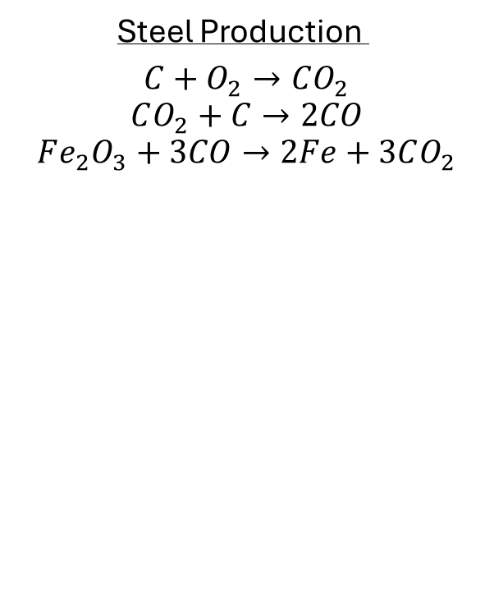
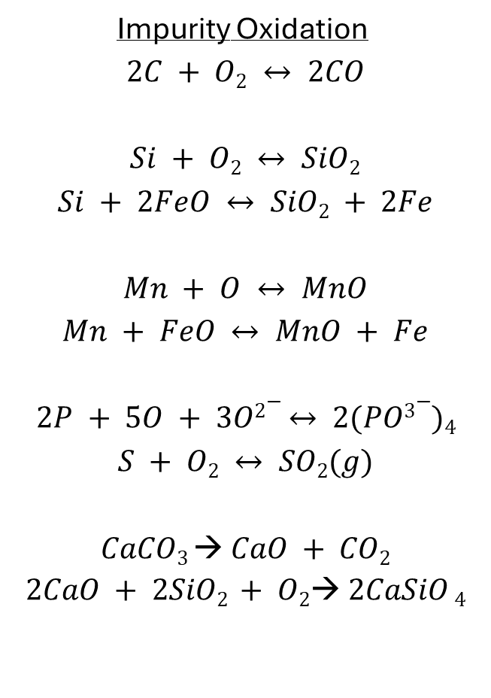
Chemical Equations
Steel Production
$$C+O_{2}→CO_{2}$$
$$CO_{2}+C→2CO$$
$$Fe_{2}O_{3}+3CO→2Fe+3CO_{2}$$
Impurity Oxidation
$$2C + O2 ↔ 2CO$$
$$Si + O2 ↔ SiO2$$
$$Si + 2FeO ↔ SiO2 + 2Fe$$
$$Mn + O ↔ MnO$$
$$Mn + FeO ↔ MnO + Fe$$
$$2P + 5O + 3O2− ↔ 2(PO3−)4$$
$$S + O2 ↔ SO2(g)$$
$$CaCO3 → CaO + CO2$$
$$2CaO + 2SiO2 + O2→ 2CaSiO 4$$
**Impurity Equations Are Exothermic

Slide 12
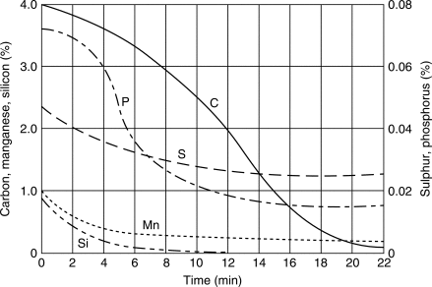
Composition of Pig Iron Impurities During Reaction
Species | %comp before | %compafter | Ratio
C | 4.00 | 0.1 | 0.025
S | 0.046 | 0.025 | 0.543
Si | 0.9 | 0 | 0
Mn | 1.00 | 0.12 | 0.12
P | 0.07 | 0.017 | 0.243
Goswami, P. (2025, January 12). LD converter process in steelmaking ► MetaTechX. MetaTechX. https://metatechx.in/ld-converter-process-in-steelmaking
Notes:
We calculated the first pass conversion of each impurity using this chart. Values on the chart were eyeballed and worked with

Slide 13

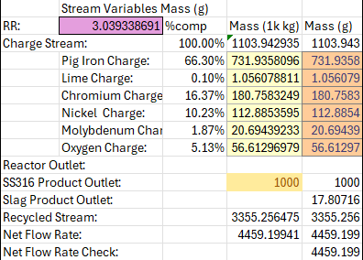
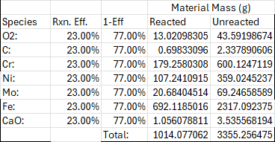
Recycle Ratio
 | Stream Variables Mass (g)
RR: | 0.160978291 | %comp | Mass (1k kg) | Mass (g)
Charge Stream: |  | 100.00% | 1103.94293 | 1103.943
 | Pig Iron Charge: | 66.30% | 731.93581 | 731.9358
 | Lime Charge: | 0.10% | 1.05607881 | 1.056079
 | Chromium Charge: | 16.37% | 180.758325 | 180.7583
 | Nickel Charge: | 10.23% | 112.885359 | 112.8854
 | Molybdenum Charge: | 1.87% | 20.6943923 | 20.69439
 | Oxygen Charge: | 5.13% | 56.6129698 | 56.61297
Reactor Outlet:
SS316 Product Outlet: |  |  | 1000 | 1000
Slag Product Outlet: |  |  |  | 17.80716
Recycled Stream: |  |  | 177.710847 | 177.7108
Net Flow Rate: |  |  | 1281.65378 | 1281.654
Net Flow Rate Check: |  |  |  | 1281.654
 |  |  | Material Mass (g)
Species | Rxn. Eff. | 1-Eff | Reacted | Unreacted
O2: | 85.00% | 15.00% | 48.1210243 | 8.491945469
C: | 85.00% | 15.00% | 0.69833096 | 0.123234875
Cr: | 85.00% | 15.00% | 179.258031 | 31.63377014
Ni: | 85.00% | 15.00% | 107.241091 | 18.9248985
Mo: | 85.00% | 15.00% | 20.6840451 | 3.650125612
Fe: | 85.00% | 15.00% | 692.118502 | 122.1385591
CaO: | 85.00% | 15.00% | 1.05607881 | 0.186366849
 |  | Total: | 1049.1771 | 177.7108475

Slide 14
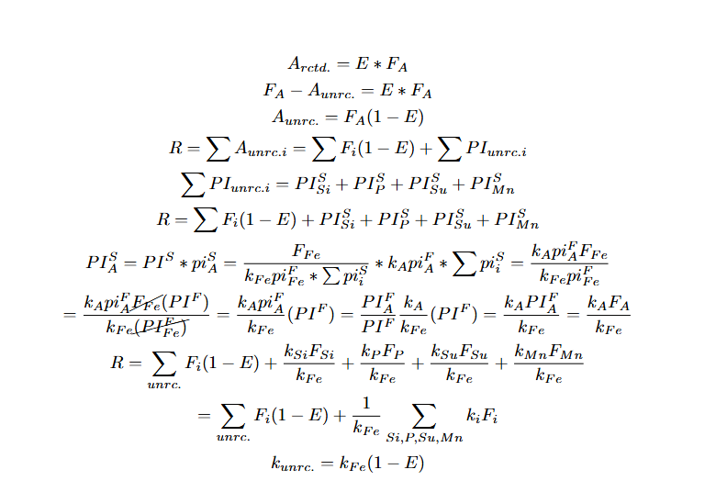
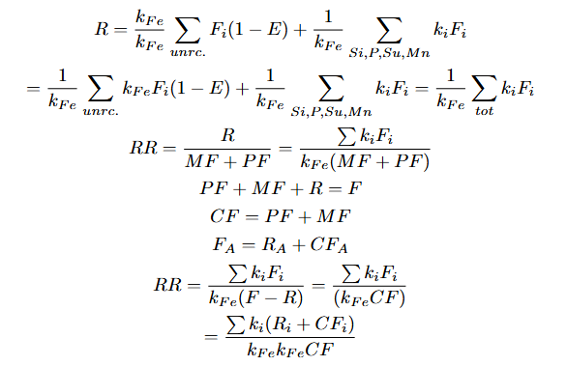
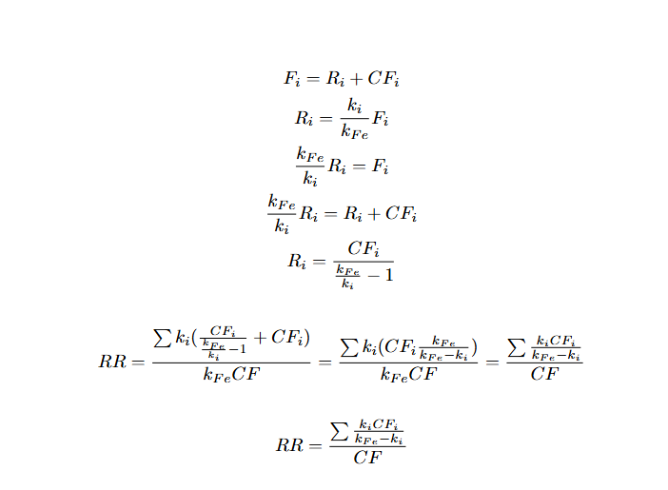
Notes:
What are these curves?

Slide 15
Reagent Breakdown
Chromium Purity
Nickel Purity
Example of Desired Product SS136
Ni: 95%
Cr: 99.17%
17% Chromium
11% Nickel
2% Molybdenum
70% Iron
0.07% Carbon
Molybdenum Purity
Pig Iron Composition
C: 4.05% S: 0.04%
Si: 0.5% Mn: 0.8%
P: 0.05%
Fe: 94.56%
Mo: 99.95%

Slide 16
Block Flow Diagram
Recycle Stream
Impure Iron, Ni, Cr, Mo,
Stream 1
CaO: 100%
Cr: 99.17%
Ni 95%
Mo 99.95
Inert
Recycle Ratio: 3:1
Recycle Stream
Product Stream (SS136)
Fe: 70%
Cr: 17.92%
Ni: 11%
Mo: 2%
C: 0.07%
Basic Oxygen Furnace
Separator
Pig Iron Stream
C: 4.05%
S: 0.04%
Si: 0.5%
Mn: 0.8%
P: 0.05%
Ti: 0.00%
Fe: 95.0%
Stream 3
Reactants
Steel
Slag
Gases
Inert
Purge Stream
CO Slag
Inert O2
Notes:
Am leaving this to Logan / Ezra; Aspen and/or by hand calculations

Slide 17
Stream Compositions
Reactor Recycled Stream:
Species | %comp | Mass (g)
C: | 0.069% | 0.123234875
Si: | 0.000% | 0
P: | 0.055% | 0.098529942
Fe: | 68.729% | 122.1385591
S: | 0.099% | 0.176396315
Mn: | 0.438% | 0.778966126
Cr: | 17.801% | 31.63377014
Ni: | 10.649% | 18.9248985
Mo: | 2.054% | 3.650125612
CaO: | 0.105% | 0.186366849
Total: | 100.000% | 177.7108475
Total: | 100.000%
SS316 Template:
Species | Mass (g) | %comp
C: | 0.7 | 0.07%
Cr: | 170 | 17.00%
Ni: | 110 | 11.00%
Mo: | 20 | 2.00%
Fe: | 699.3 | 69.93%
Total: | 1000 | 100.00%
Reactor Outlet Stream Composition
Fe(total): | 814.2571
Unreacted Reagents
1st-pass% (of %comp): |  | %comp | %corrected | Mass (g)
C: | 2.50% | 0.101% | 0.101% | 0.821565836
Si: | 0.00% | 0.000% | 0.000% | 0
P: | 24.29% | 0.012% | 0.012% | 0.098529942
S: | 54.35% | 0.022% | 0.022% | 0.176396315
Mn: | 12.00% | 0.096% | 0.095% | 0.778966126
Fe(total): | 106.12% | 100.35% | 99.770% | 814.2570607
Total: | N/A | 100.58% | 100.000% | 816.1325189
 |  |  | Material Mass (g)
Species | Rxn. Eff. | 1-Eff | Reacted | Unreacted
O2: | 85.00% | 15.00% | 48.1210243 | 8.491945469
C: | 85.00% | 15.00% | 0.69833096 | 0.123234875
Cr: | 85.00% | 15.00% | 179.258031 | 31.63377014
Ni: | 85.00% | 15.00% | 107.241091 | 18.9248985
Mo: | 85.00% | 15.00% | 20.6840451 | 3.650125612
Fe: | 85.00% | 15.00% | 692.118502 | 122.1385591
CaO: | 85.00% | 15.00% | 1.05607881 | 0.186366849
 |  | Total: | 1049.1771 | 177.7108475
Slag Product (g): |  |  | SS316 Tot. Similarity:
 | 20.79534 |  |  | 99.01%
Purge Stream (g): |  |  | SS316 Tot. Mass (g):
 | 83.1476 |  |  | 1000
Charge Stream Composition |  |  | %comp by mass
 |  | Mass (g) |  |  | Mass (g)
Pig Iron Stream | %comp | 66.30% | Cr Stream | %comp | 16.37%
C: | 4.05% | 29.6434 | Cr: | 99.17% | 179.2580308
Si: | 0.50% | 3.659679 | Inerts: | 0.83% | 1.500294097
P: | 0.05% | 0.365968 | Total: | 100.00% | 180.7583249
Fe: | 94.56% | 692.1185 | Ni Stream | %comp | 10.23%
S: | 0.04% | 0.292774 | Ni: | 95.00% | 107.2410915
Mn: | 0.80% | 5.855486 | Inerts: | 5.00% | 5.644267973
Ti: | 0.00% | 0 | Total: | 100.00% | 112.8853595
Inerts: | 0.00% | 0 | Mo Stream | %comp | 1.87%
Total: | 100.00% | 731.9358 | Mo: | 99.95% | 20.68404514
Lime Stream: | %comp | 0.10% | Inerts: | 0.05% | 0.010347196
CaO: | 100% | 1.056079 | Total: | 100.00% | 20.69439233
O2: | 100% | 56.61297

Slide 18
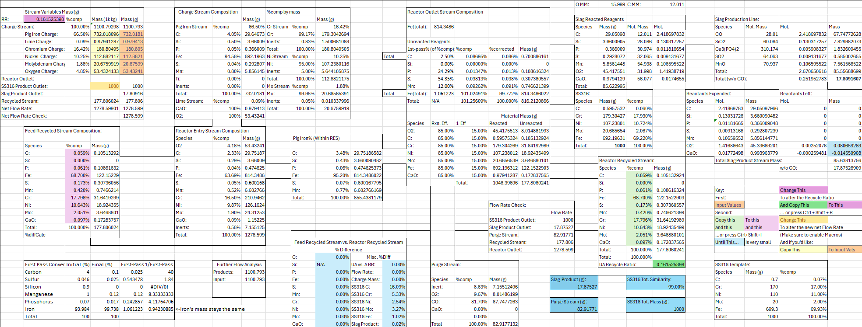
The Real Block Flow Diagram

Slide 19
Energy Balance

Slide 20
Block Flow Diagram
25°C, 1atm
Recycle Stream
Impure Iron, Ni, Cr, Mo,
Stream 1
CaO: 100%
Cr: 99.17%
Ni 95%
Mo 99.95
Inert
Recycle Stream
Recycle Ratio: 3:1
Product Stream (SS136)
Fe: 70%
Cr: 17.92%
Ni: 11%
Mo: 2%
C: 0.07%
??? °C
1700°C
Basic Oxygen Furnace
1700°C
Separator
1700°C
Pig Iron Stream
C: 4.05%
S: 0.04%
Si: 0.5%
Mn: 0.8%
P: 0.05%
Ti: 0.00%
Fe: 95.0%
Stream 3
Reactants
Steel
Slag
Gases
Inert
Purge Stream
CO Slag
Inert O2
1700°C
Notes:
Am leaving this to Logan / Ezra; Aspen and/or by hand calculations

Slide 21
Assumptions
Fresh Feed at STP
No atmospheric change
0.16 RR; 85% FPC
Inert material is insignificant
No heat loss in transportation
Things that can melt, will melt

Slide 22
Energy Balance
$$ΔH+ΔE_{K}+ΔE_{P}=Q−W_{S}$$
Energy Balance Equation

Slide 23
Energy Balance
0
0
0
$$ΔH+ΔE_{K}+ΔE_{P}=Q−W_{S}$$
No kinetic energy
No potential energy
No shaft work

Slide 24
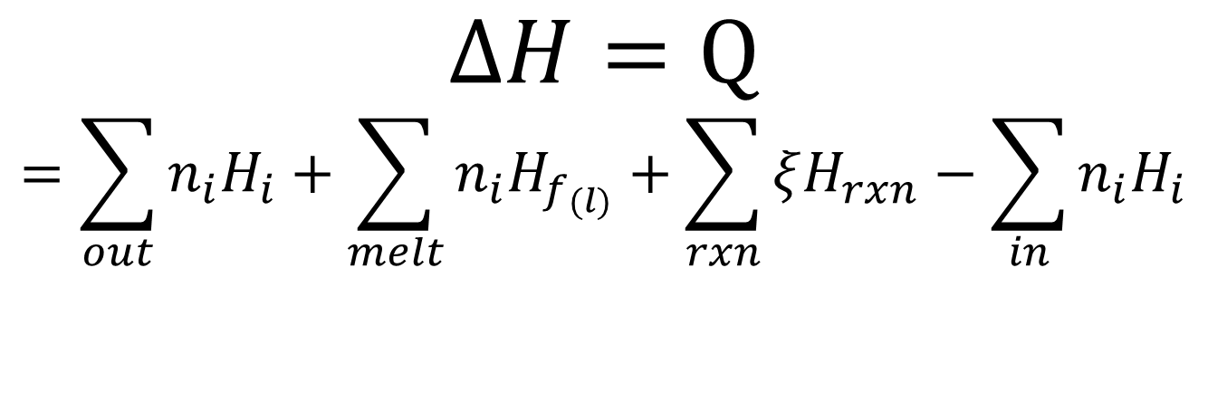
Energy Balance
$$ΔH=Q$$
$$=\sum_{out}{n_{i}H_{i}}+\sum_{melt}{n_{i}H_{f_{(l)}}}+\sum_{rxn}{ξH_{rxn}}−\sum_{in}{n_{i}H_{i}}$$
Specific Heat
Heat of Reaction
Inlet stream NOT at STP

Slide 25

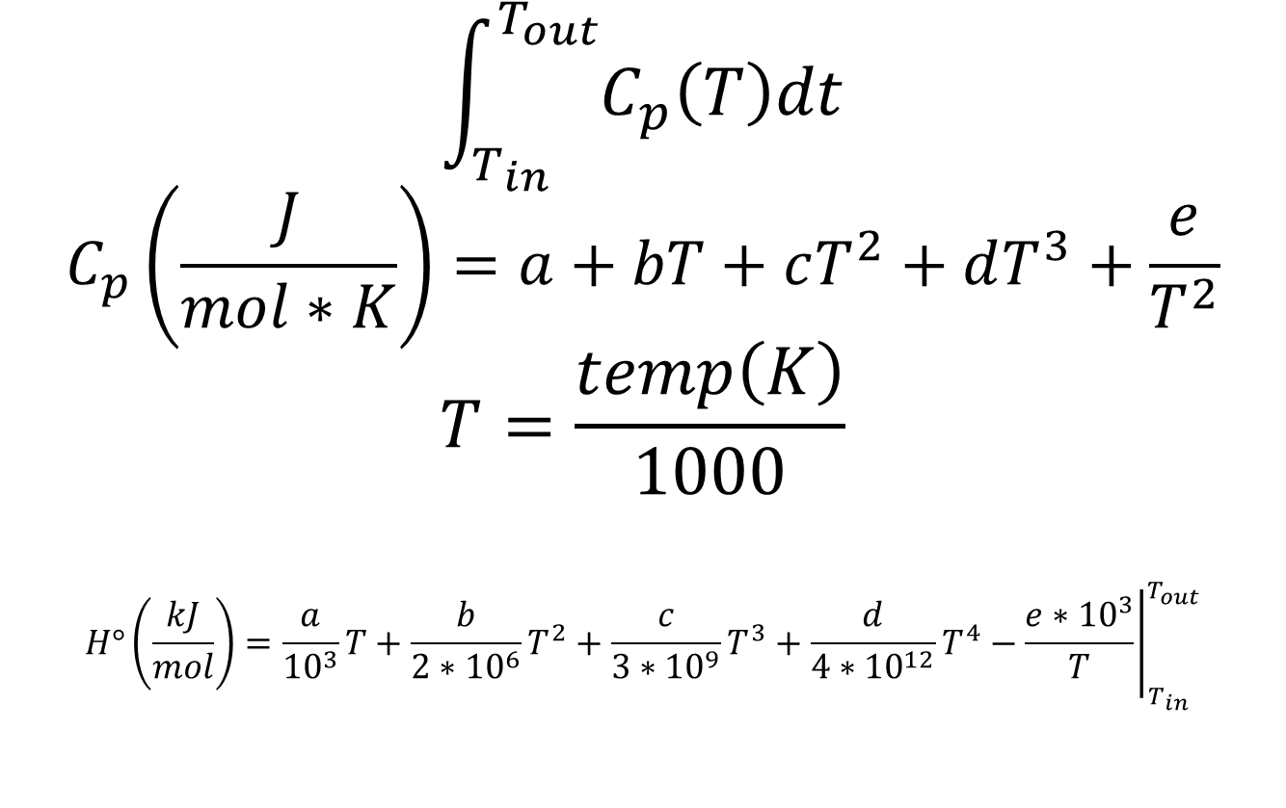
Energy Balance
$$\sum_{out}{n_{i}H_{i}}$$
$$\int_{T_{in}}^{T_{out}}{C_{p}\left(T\right)dt}$$
$$C_{p}\left(\frac{J}{mol∗K}\right)=a+bT+cT^{2}+dT^{3}+\frac{e}{T^{2}}$$
$$T=\frac{temp\left(K\right)}{1000}$$
$$H°\left(\frac{kJ}{mol}\right)={\left.\frac{a}{{10}^{3}}T+\frac{b}{2∗{10}^{6}}T^{2}+\frac{c}{3∗{10}^{9}}T^{3}+\frac{d}{4∗{10}^{12}}T^{4}−\frac{e∗{10}^{3}}{T}\right|}_{T_{in}}^{T_{out}}$$
Specific Heat values
Equation NIST uses
Values found from NIST WebBook & other tables

Slide 26
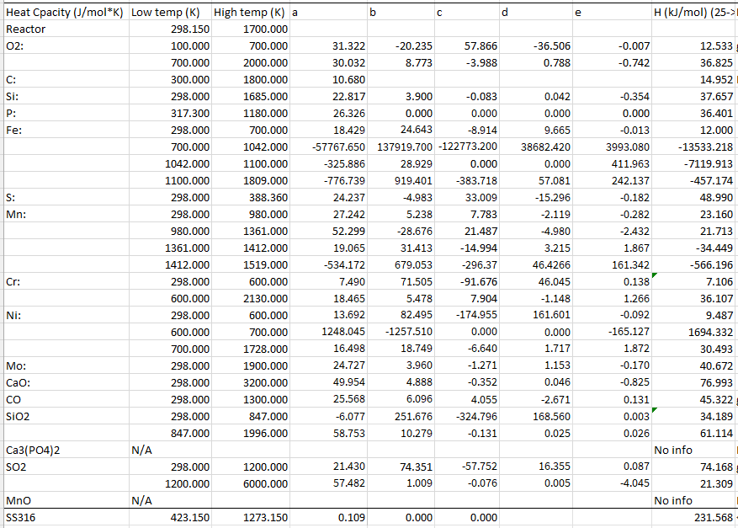
Energy Balance
$$\sum_{out}{n_{i}H_{i}}$$
NIST WebBook values
Steel values are from Office of Scientific and Technical Information (OSTI)
From 25°C – 1700°C

Slide 27
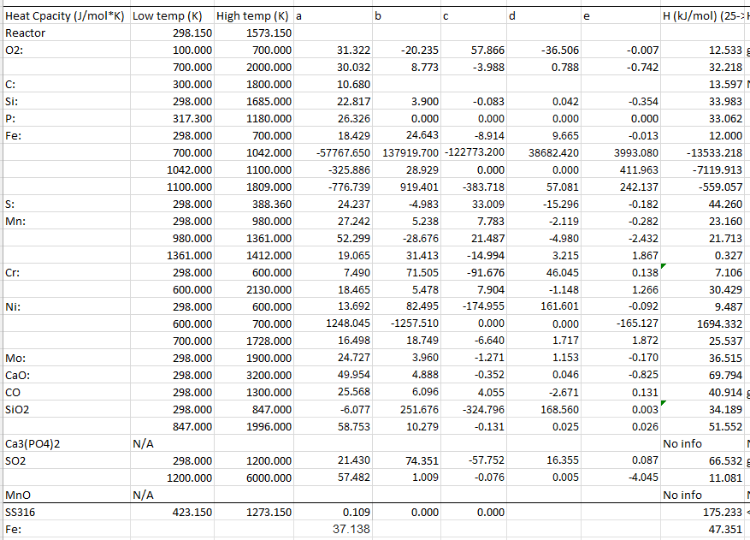
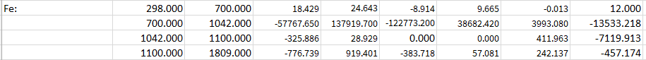
Energy Balance
$$\sum_{out}{n_{i}H_{i}}$$
Iron’s values don’t seem correct…
NIST WebBook Iron
JANAF-NIST Iron
Temp Range (K) | H (kJ/mol)
298-700 | 12.000
700-1042 | -13533.218
1042-1100 | -7119.913
1100-1700 | -559.057
Sum: | -21200.188
Temp Range (K) | H (kJ/mol)
0-1184 | 26.960
1184-1665 | 33.619
1665-1700 | 52.621
Sum: | 113.2
Notes:
Point this out briefly

Slide 28
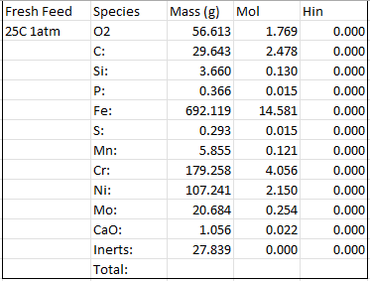
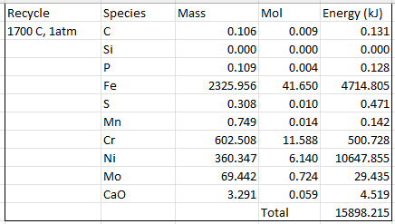

Energy Balance
$$\sum_{in}{n_{i}H_{i}}$$
Inlet stream at STP… almost
Values from NIST WebBook

Slide 29
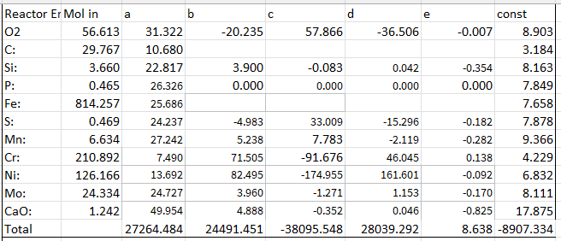
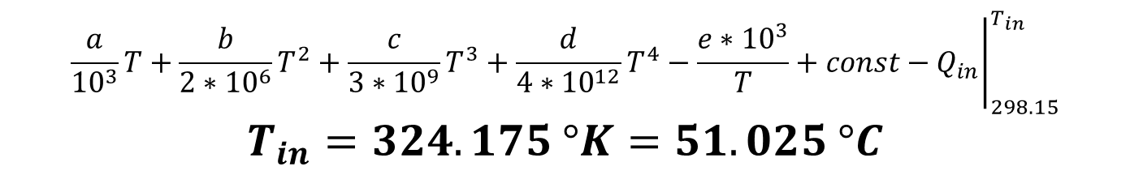
Energy Balance
$$\sum_{in}{n_{i}H_{i}}$$
Inlet stream NOT at STP
Values from NIST WebBook
Heat of fusion was not accounted for
$${\left.\frac{a}{{10}^{3}}T+\frac{b}{2∗{10}^{6}}T^{2}+\frac{c}{3∗{10}^{9}}T^{3}+\frac{d}{4∗{10}^{12}}T^{4}−\frac{e∗{10}^{3}}{T}+const−Q_{in}\right|}_{298.15}^{T_{in}}$$
$$T_{in}=324.175 °K=51.025 °C$$

Slide 30
Block Flow Diagram
25°C, 1atm
Recycle Stream
Impure Iron, Ni, Cr, Mo,
Stream 1
CaO: 100%
Cr: 99.17%
Ni 95%
Mo 99.95
Inert
Recycle Stream
Recycle Ratio: 3:1
Product Stream (SS136)
Fe: 70%
Cr: 17.92%
Ni: 11%
Mo: 2%
C: 0.07%
51 °C
1700°C
Basic Oxygen Furnace
1700°C
Separator
1700°C
Pig Iron Stream
C: 4.05%
S: 0.04%
Si: 0.5%
Mn: 0.8%
P: 0.05%
Ti: 0.00%
Fe: 95.0%
Stream 3
Reactants
Steel
Slag
Gases
Inert
Purge Stream
CO Slag
Inert O2
1700°C
Notes:
Am leaving this to Logan / Ezra; Aspen and/or by hand calculations

Slide 31
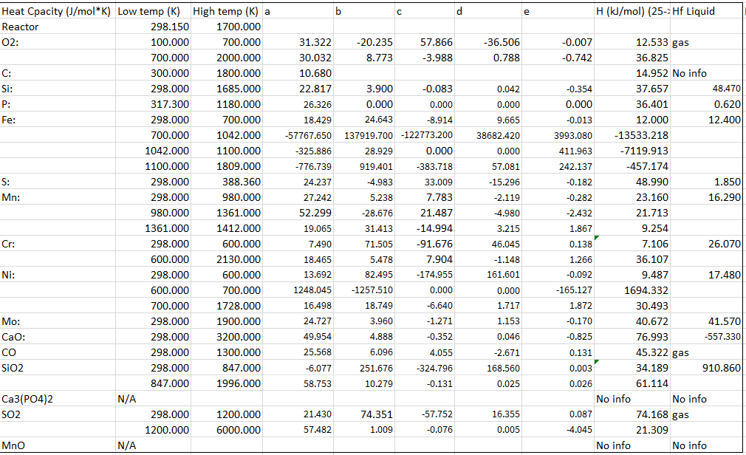

Energy Balance
$$\sum_{melt}{n_{i}H_{f_{(l)}}}$$
Things melt!
NIST breaks up values

Slide 32
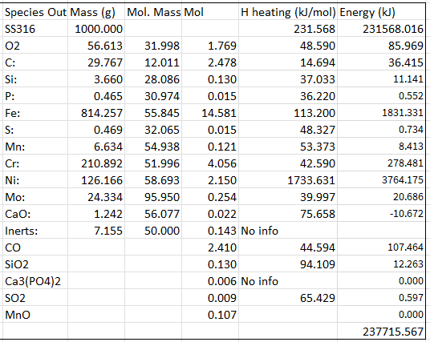

Energy Balance
$$\sum_{out}{n_{i}H_{i}}+\sum_{melt}{n_{i}H_{f_{(l)}}}$$
Calculate outlet stream from 51°C to 1700°C
237,715.567 kJ/kg SS316

Slide 33
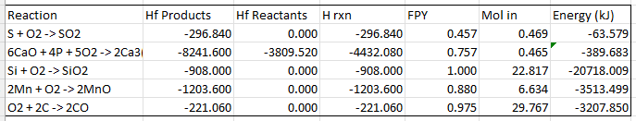

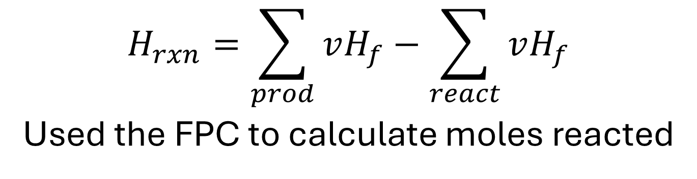
Energy Balance
$$\sum_{rxn}{ξH_{rxn}}$$
$$H_{rxn}=\sum_{prod}{vH_{f}}−\sum_{react}{vH_{f}}$$
Used the FPC to calculate moles reacted
Heat of reaction
Products – reactants
Extent of reaction calculated using FPY
NIST WebBook
-27,892.619 kJ/kg SS316

Slide 34
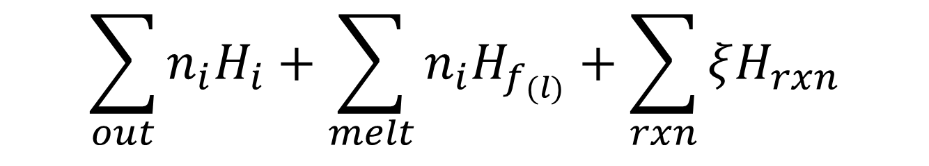
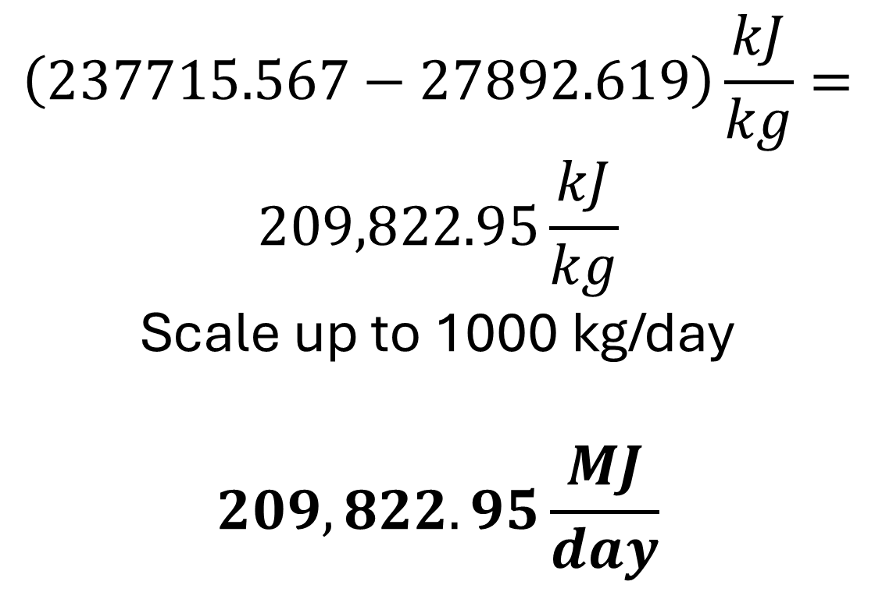
Energy Balance
$$\sum_{out}{n_{i}H_{i}}+\sum_{melt}{n_{i}H_{f_{(l)}}}+\sum_{rxn}{ξH_{rxn}}$$
$$\left(237715.567−27892.619\right)\frac{kJ}{kg}=$$
$$209,822.95\frac{kJ}{kg}$$
Scale up to 1000 kg/day
$$209,822.95\frac{MJ}{day}$$
Scale it up!
Endothermic
A higher recycle ratio will yield a lower value

Slide 35
Atom & Process Economy

Slide 36
Atom Economy Calculations
Total Mass - 90.82%
Species | Mass | Mol. Mass | Moles
Pig Iron: | 731.9358096 | 15.1194157 | 15.1194157
Lime: | 1.056078811 | 56.077 | 0.018832655
Cr: | 180.7583249 | 51.996 | 3.476389048
Ni: | 112.8853595 | 58.693 | 1.923318956
Mo: | 20.69439233 | 95.95 | 0.21567892
O2: | 56.61296979 | 31.998 | 1.769265885
Total: | 1103.942935 | 49.01424231 | 22.52290116
Notes:
It doesn’t make sense for us to have an atom economy because the reactions are only purifying the already created iron. We are also making an alloy which is just mixing. Like think about trail mix
Atom economy tells us how efficiently the atoms from our reactants end up in the final SS316 product. We start with pig iron, oxygen, lime, and pure alloying metals. But not all of those atoms make it into the steel—many go into slag or off-gas when impurities like Si, Mn, P, S, and carbon are removed.
Because steelmaking requires oxidation and impurity removal, a large fraction of atoms must leave the system, which inherently lowers atom economy. So AE gives us the theoretical chemical efficiency of the process, independent of cost or real operational losses.

Slide 37
Process Economy Calculations
Species | Price (USD) | Per Unit | Per Unit (g) | Mass Req | Cost | Upscaled | Upsc./year
Pig Iron: | $300.00 | ton | $0.0003000 | 731.93581 | $0.22 | $219.58 | $80,146.97
Lime: | $20.00 | ton | $0.0000200 | 1.05607881 | $0.00 | $0.02 | $7.71
Cr: | $10.00 | kg | $0.0100000 | 180.758325 | $1.81 | $1,807.58 | $659,767.89
Ni: | $20.00 | kg | $0.0200000 | 112.885359 | $2.26 | $2,257.71 | $824,063.12
Mo: | $78.00 | kg | $0.0780000 | 20.6943923 | $1.61 | $1,614.16 | $589,169.35
O2: | $0.00 | g | $0.0000000 | 56.6129698 | $0.00 | $0.00 | $0.00
Totals: |  |  | $0.1083200 |  | $5.90 | $5,899.05 | $2,153,155.04
Products: |  |  |  | Produced | Revenue |  | $0.00
SS316: | $6,000.00 | ton | $0.0060000 | 1000 | $6.00 | $6,000.00 | $2,190,000.00
Slag: | $60.00 | ton | $0.0000600 | 83.1475951 | $0.00 | $4.99 | $1,820.93
Totals: |  |  | $0.0060600 |  | $6.00 | $6,004.99 | $2,191,820.93
Profit (yearly): $38,665.89
Notes:
Process economy looks at real industrial efficiency—how much of our input materials and costs are converted into sellable SS316. It includes everything atom economy does not: slag generation, purge losses, alloy costs, oxygen use, and the recycle ratio.
Here, SS316 is the main revenue stream, while slag has minimal value. PE tells us how profitable and efficient the actual BOF and alloying process is, rather than how efficient it is on paper.
But because of our location we are able to sell the slag to neighboring places so we are also able to make a profit from it. Which we will go over in a bit.

Slide 38
Real Life Applications

Slide 39
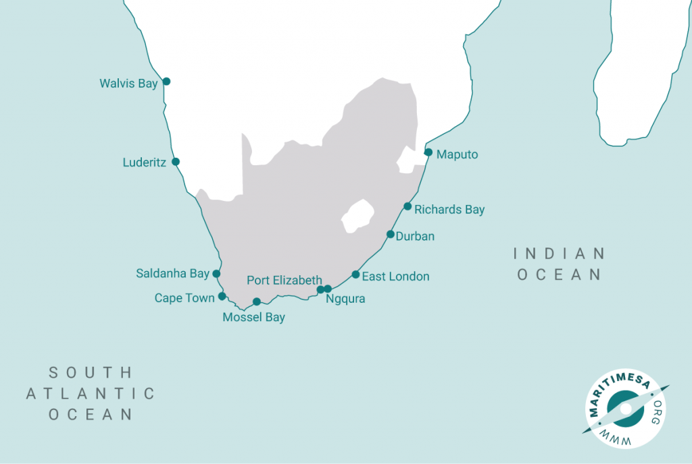



Location
Coega SEZ, South Africa
Low cost for alloys and pig iron
High selling price of SS316
Port city; can export easily
Economic incentives in SEZs
Proximity to potential clients
Notes:
Lower costs for raw materials
South Africa is the 7th largest producer of iron ore
High selling price of SS316
Location we have chosen: Port Elizabeth and Port of Nqgura
Trade to China, US, Germany
Special Economic Zone: designated area with different economic policies to support targeted economic activities and draw in investors
Reduced corporate income tax, building allowances, tax reliefs on employment, customs controlled area, pre-existing services and infrastructure
Potential Clients
Cemza: cement to sell slag
Hella marine: miritime lighting and electronics that must withstand saltwater

Slide 40
Ideal Profit
Scaling the Process economy up from small scale:
Upsale: | 1000 kg/day
Conversions:
Ton ->Kg-> Grams
1 | 1000 | 1000000
Costs Analysis
Species | Price (USD) | Per Unit | Per Unit (g) | Mass Req | Cost | Upscaled | Upsc./year
Pig Iron: | $250.00 | ton | $0.0002500 | 731.93581 | $0.18 | $182.98 | $66,789.14
Lime: | $20.00 | ton | $0.0000200 | 1.05607881 | $0.00 | $0.02 | $7.71
Cr: | $5.00 | kg | $0.0050000 | 180.758325 | $0.90 | $903.79 | $329,883.94
Ni: | $10.00 | kg | $0.0100000 | 112.885359 | $1.13 | $1,128.85 | $412,031.56
Mo: | $55.00 | kg | $0.0550000 | 20.6943923 | $1.14 | $1,138.19 | $415,439.93
O2: | $0.00 | g | $0.0000000 | 56.6129698 | $0.00 | $0.00 | $0.00
Totals: |  |  | $0.0702700 |  | $3.35 | $3,353.84 | $1,224,152.28
Products: |  |  |  | Produced | Revenue |  | $0.00
SS316: | $6,000.00 | ton | $0.0060000 | 1000 | $6.00 | $6,000.00 | $2,190,000.00
Slag: | $60.00 | ton | $0.0000600 | 83.1475951 | $0.00 | $4.99 | $1,820.93
Totals: |  |  | $0.0060600 |  | $6.00 | $6,004.99 | $2,191,820.93
Profit (yearly): $967,668.65
Notes:
Process economy = actual products on Alibaba
Here = general prices of raw materials in South Africa
Ideal profit = increased profit, can sell steel as lost as $3500

Slide 41
Thank You

Slide 42
References
Asia for Educators, C. U. (n.d.). China in 1000 CE. Song Dynasty China | Asia for Educators. https://afe.easia.columbia.edu/songdynasty-module/econ-rev-iron-steel.html (slide 5)
AMC. (2025, Mar 5). What is stainless steel 316? uses, grades, and composition. Amardeep Steel Centre. https://www.amardeepsteel.com/blog/what-is-stainless-steel-316-uses-grades-and-composition.html (slide 39)
Benefits of operating within special economic zones (2025). investSA. https://www.investsa.gov.za/special-economic-zones/ (slide 39)
Cemza cement products (2025). Cemza Engineered Cement. https://cemza.co/cement-products/ (slide 39)
Henry Bessemer | Biography, inventions, & facts | britannica. (n.d.-a). https://www.britannica.com/biography/Henry-Bessemer (slide 4)
Iron ore production in south africa and major projects (2024, Aug 23). Mining Technology. https://www.mining-technology.com/data-insights/iron-ore-in-south-africa/?cf-view (slide 39)
Kadezabek, S. (2025, June 11). History of steel: Ancient invention to modern innovations. Service Steel Warehouse. https://www.servicesteel.org/resources/history-of-steel (slide 5)
Materials processing | definition, examples, types, & facts | britannica. (n.d.-c). https://www.britannica.com/technology/materials-processing (slide 3)
Maximizing efficiency and safety in pharmaceutical research and manufacturing with Stainless Steel. The Stainless Steel Solution: Enhancing Pharmaceutical Manufacturing and Research Safety. (n.d.). https://www.unifiedalloys.com/blog/stainless-steel-benefits-pharma (slide 6)
Metallurgy - iron, steel, alloy | britannica. (n.d.-d). https://www.britannica.com/science/metallurgy/Ferrous-metals (slide 4)
Metals, A. (2023, July 18). Why 316 stainless steel is optimal for Food Processing Equipment. Alliant Metals Inc. https://alliantmetals.com/316-stainless-steel-the-optimum-choice-food-processing/ (slide 6)
SEZ investments (2025). COEGA. https://www.coega.co.za/site/sez-investments (slide 39)
South africa exports by country (2025). https://tradingeconomics.com/south-africa/exports-by-country (slide 39)
Srinivasan, S. (n.d.). Wootz Steel: An Advanced Material of the Ancient World. Wootz Steel: An advanced material of the Ancient World. https://dtrinkle.matse.illinois.edu/MatSE584/articles/wootz_advanced_material/wootz_steel.html (slide 5)
Stainless steel use in marine applications. Stainless Steel Use in Marine Application - Unified Alloys. (n.d.). https://www.unifiedalloys.com/blog/stainless-steel-marine-applications (slide 6)
Stone-working and the earliest steel in Iberia: Scientific analyses and experimental replications of Final bronze age stelae and tools - sciencedirect. (n.d.-e). https://www.sciencedirect.com/science/article/abs/pii/S0305440323000201 (slide 5)
What is stainless steel 316?: Uses, grades, and composition. What is Stainless Steel 316?: Uses, Grades, and Composition. (n.d.). https://www.amardeepsteel.com/blog/what-is-stainless-steel-316-uses-grades-and-composition.html (slide 6)
Wikimedia Foundation. (2025a, April 18). Robert Durrer. Wikipedia. https://en.wikipedia.org/wiki/Robert_Durrer (slide 4)
Wikimedia Foundation. (2025b, October 27). Wootz Steel. Wikipedia. https://en.wikipedia.org/wiki/Wootz_steel (slide 5)
WorldAtlas. (2021, February 25). Austria Maps & Facts. https://www.worldatlas.com/maps/austria (slide 3)

